Slide 1
BIKE Sharing: Lessons learnt from an analysis of Usage
The troublesome four:
Travis
The mastermind
Sasmita
the developer
Derek
the charismatic
Laci
the intern
Notes:
Laci was introduce the project to the class

Slide 2

Question?
What are the determining factors that drive the demand on bike share rentals
Notes:
Laci

Slide 3
Hypothesis
We hypothesize that bike rental activity and demanding customers depend on station locations in good season and good temperature.

Slide 4

Why bikeshare?
Convenient , affordable and efficient
short range transportation options
to travel without being stuck in traffic
Especially in crowded or busy areas
like cities' downtown
Enjoy the city
Even workout at the same time
Notes:
Laci

Slide 5

Capital bikeshare
Services Washington, DC and surrounding areas beginning 2010.
It was the largest bike sharing service until the City Bike for New York City, which started in 2013.
Capital Bikeshare started with 10 stations and 120 bicycles in Washington, DC.
Now they have 500+ stations with 4500 bikes across 7 jurisdictions.
Notes:
Laci will provide the 7 jurisdictions:
Washington, DC
Arlington, VA
Alexandria, VA
Montgomery, MD
Prince George's County, MD
Fairfax County, VA
City of Falls Church, VA

Slide 6
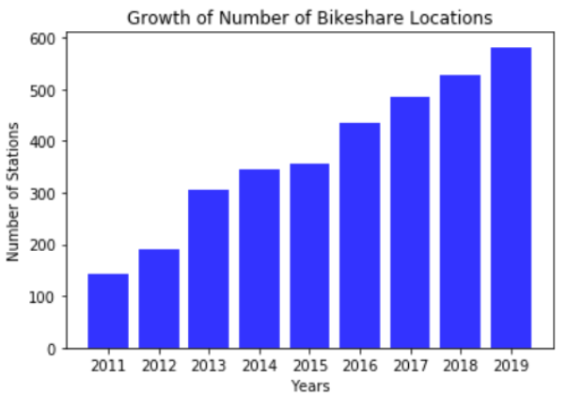
Notes:
Travis will go over this part:
-Travis’s Bar chart on the increasing stations from 2011 to present time
2011- 144 stations 2019- 582 stations

Slide 7
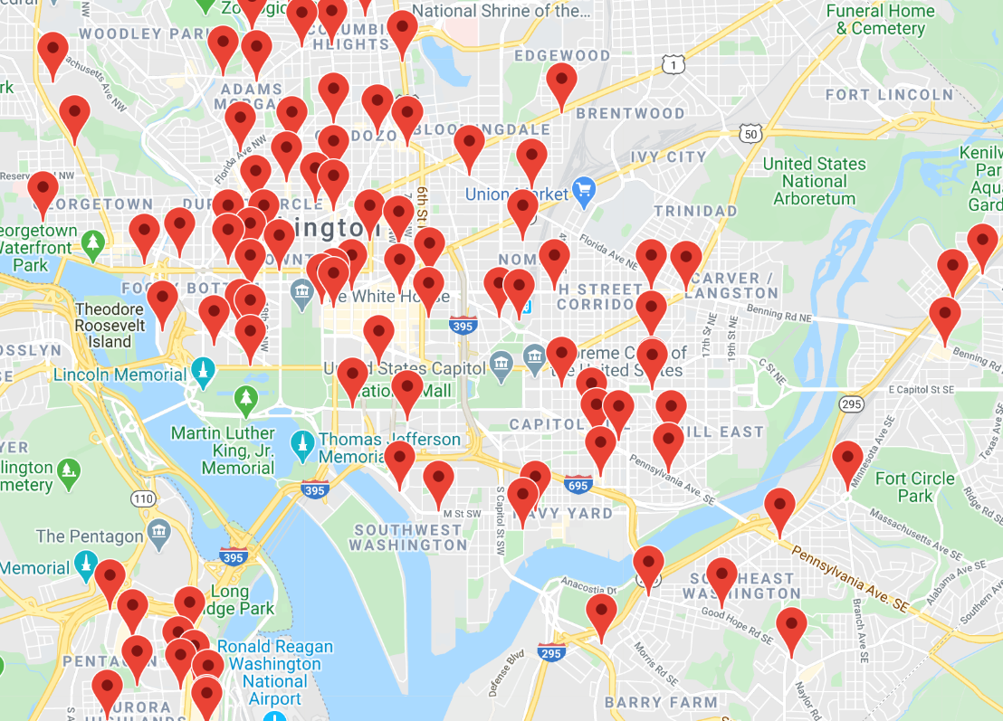
Locations 2011
Notes:
Travis will go over 2011, afterward this slide will be the recent/current location map

Slide 8
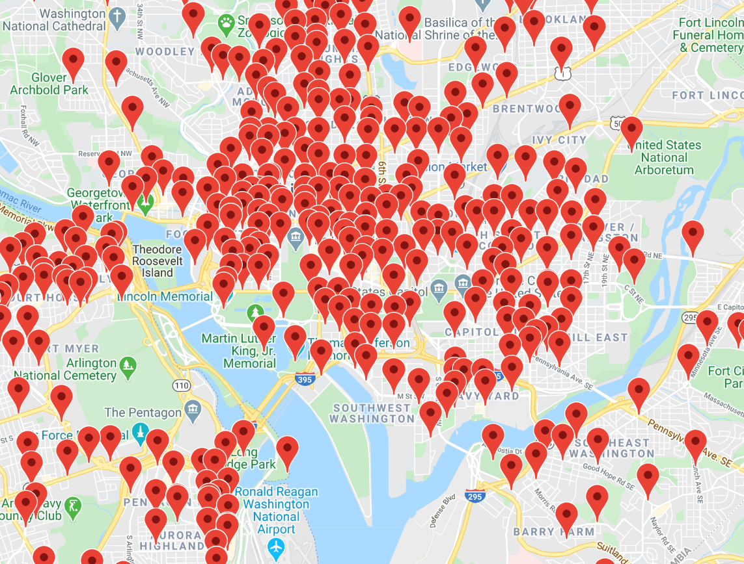
Location 2020
Notes:
Travis will go over Location/Marker Map (recent/current map)

Slide 9
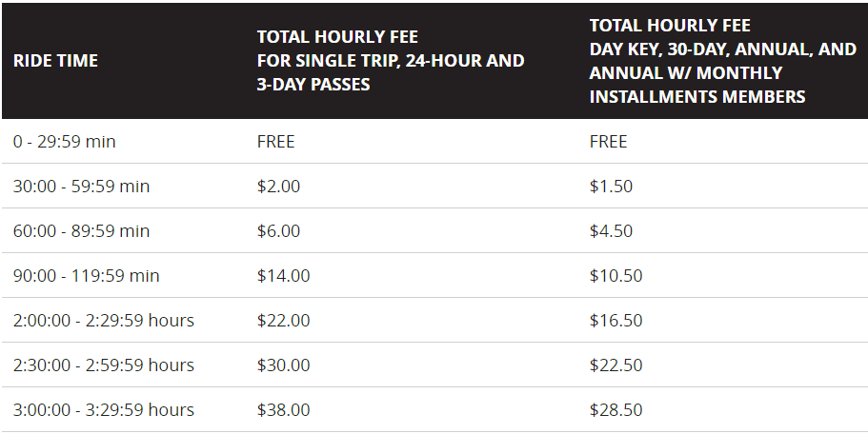
Just for kicks: Pricing
Notes:
Laci will provide pricing (which will make sense for following slides and plots). After this, Derek will take over….

Slide 10
About the Data:
Downloaded from UCI Archive
Data points include hourly entries sampled from Washington D.C. spanning two years dating from January 1st, 2011 to December 19th, 2012 (17379 hours)
Also contains weather data for the corresponding date and time
Capital Bikeshare Trip Data from 2010 to 2019 for each quarter
Google API to pull Lat, Long for Capital Bike Share stations
Notes:
Derek will take over from this slide:

Slide 11
Data cleaning
We had a clean dataset for our historic data.
The Data Set had normalized values for temperature (41) in Celsius , humidity(100) and windspeed(67).
We took the normalization off by multiplying respective variables by their normalizing factors and converted temperature to Fahrenheit.
Notes:
Derek’s part:

Slide 12
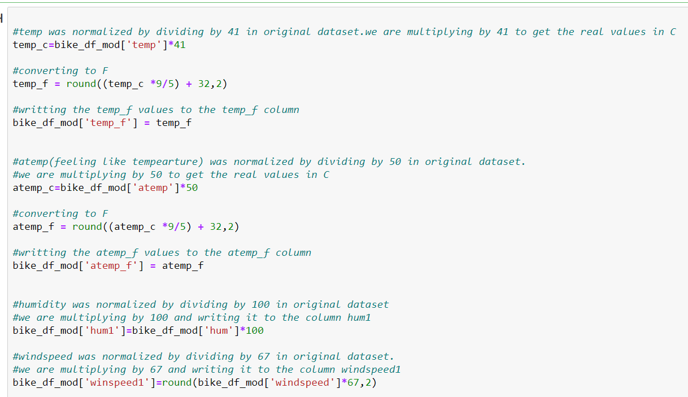
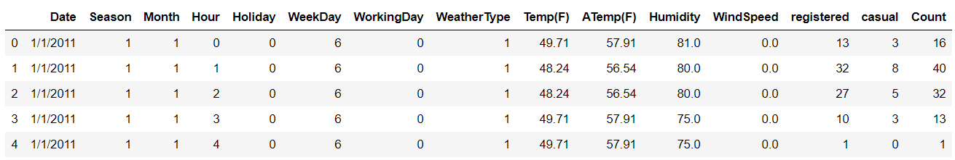
Data cleaning process

Slide 13
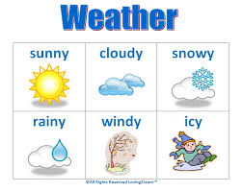



factors
Notes:
Derek’s part:

Slide 14
Plots
Get ready for more kicks
Notes:
Derek’s part:

Slide 15
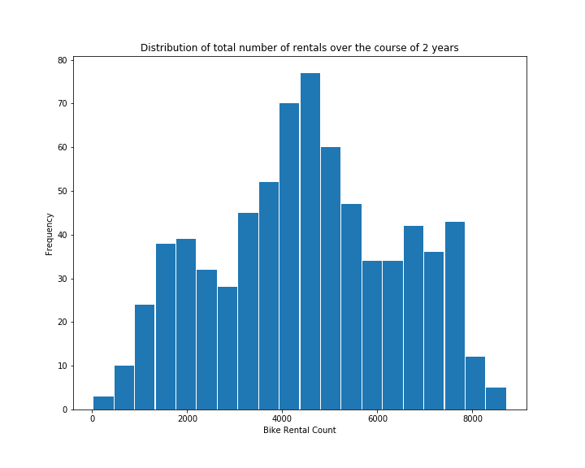
Total Bike rental count distribution
Notes:
Derek’s part:
From the histogram above, it seems that the number of total rented bikes follow a nearly normal distribution.
We did a normal test on this data using ‘normaltest’ : stats.normaltest(count_per_day['cnt'].sample(100))
Result : NormaltestResult(statistic=3.556698284796563, pvalue=0.16891677475983022)
For few samples , we got pvalue more than 0.05.

Slide 16
The impact of weather
Notes:
Derek’s will introduce into weather impacts

Slide 17
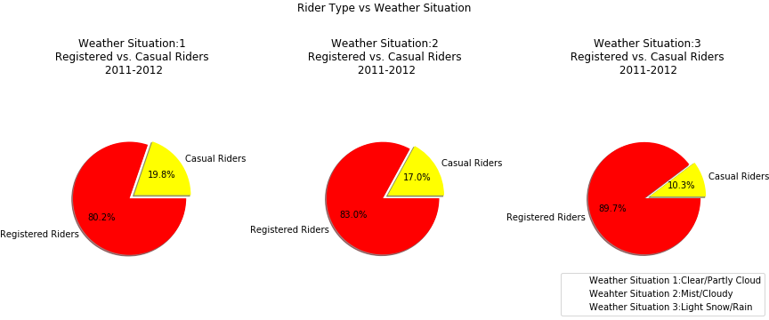
Weather impact on ride count
Notes:
Derek’s Pie Chart

Slide 18
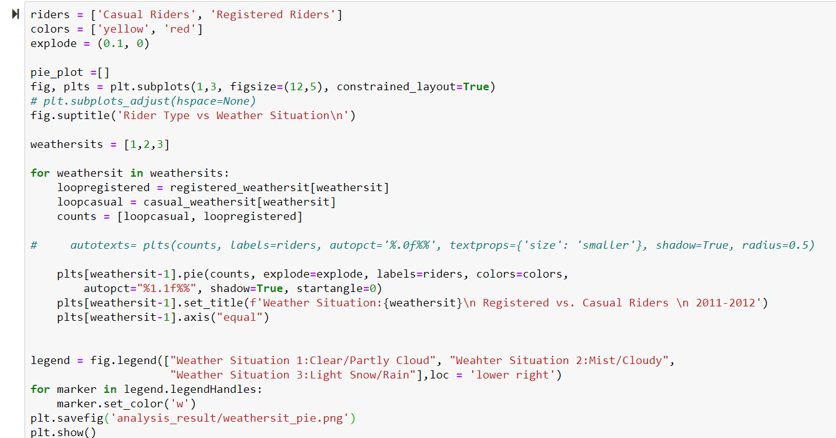
For pie chart
Notes:
Derek will go over his coding for the pie chart plots. Afterwards, Sasmita will take over

Slide 19
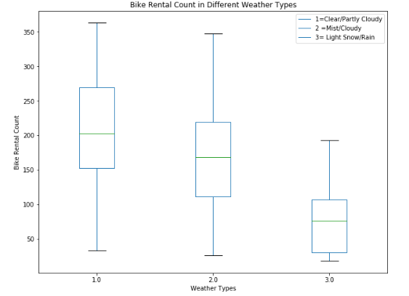
Rental count vs weather type
Notes:
Sasmita will take over from here: Box-plot
The box plot shows the relationship between average rental count and weather. There is a clearly decreasing trend of bike rentals when weather conditions grow worse.

Slide 20
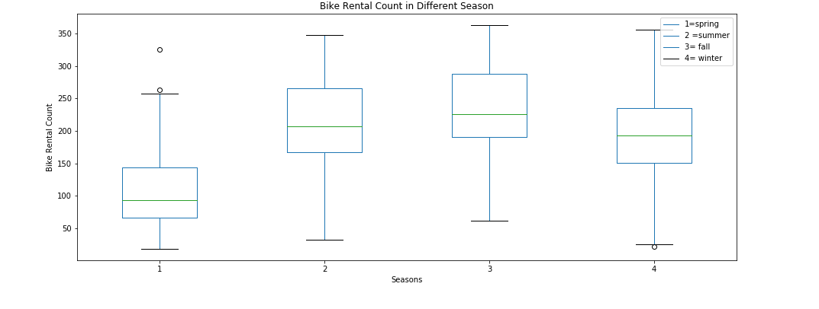
rental count during seasons
Notes:
Sasmita’s part:
Box-plot of ride duration based on season:
The median of bike rental count in spring is: 93.167
Values below -48.826 could be outliers.
Values above 259.696 could be outliers.
The median of bike rental count in summer is: 206.958
Values below 18.417 could be outliers.
Values above 414.083 could be outliers.
The median of bike rental count in fall is: 225.521
Values below 45.203 could be outliers.
Values above 434.828 could be outliers.
The median of bike rental count in winter is: 193.104
Values below 25.083 could be outliers.
Values above 359.917 could be outliers.

Slide 21
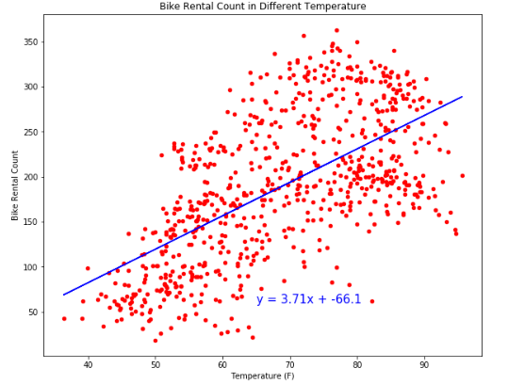
rental count vs temperature
Notes:
Sasmita’s part:
Scatterplot of Average Rental Count vs Temperatures:
Seem to have a linear relationship with a correlation factor of 0.63.

Slide 22
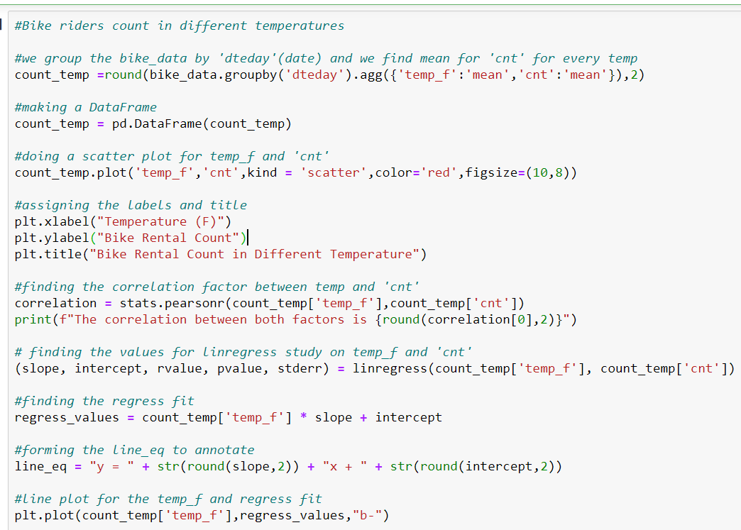
Linear Regression
Notes:
Sasmita

Slide 23

When is the bike action?
Notes:
Sasmita

Slide 24
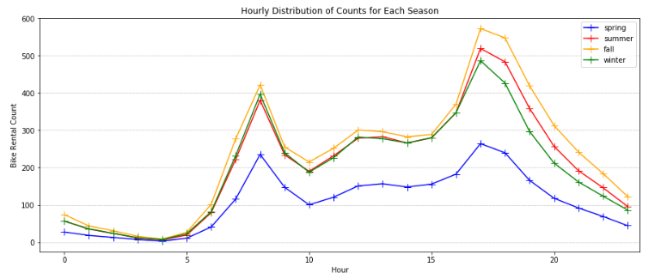
hourly Ride Count in different seasons
Notes:
Sasmita’s part:
Peak Time: 8 am and 5 pm

Slide 25
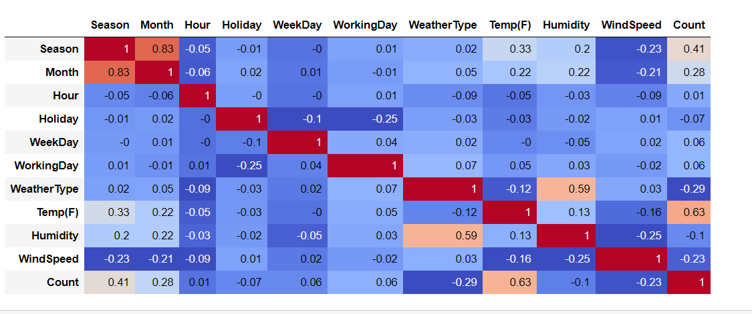
Correlation Matrix
Notes:
Sasmita will go over, then Travis will take over.

Slide 26
Where is the bike action?
Notes:
Travis will take over from here

Slide 27
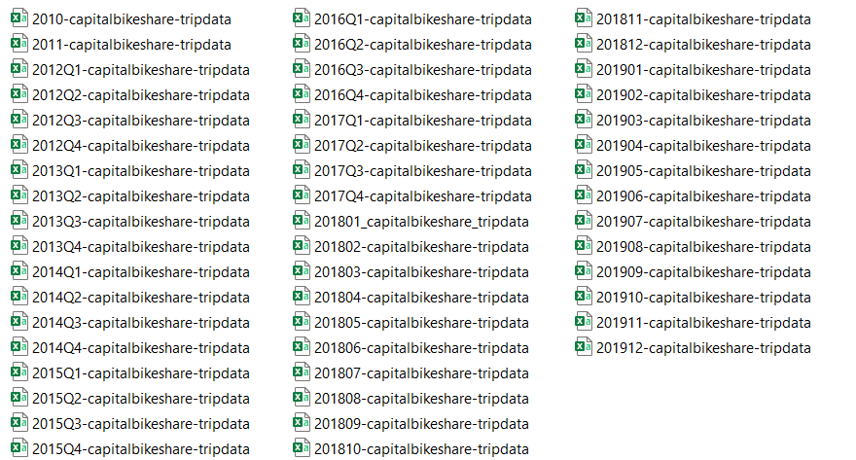
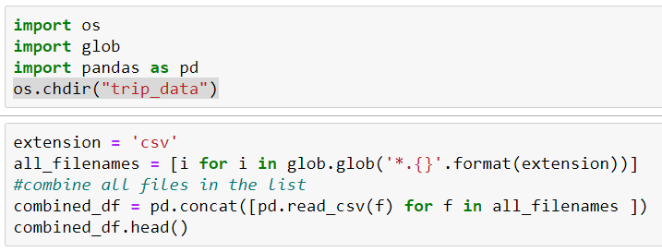
Heat Map DAta
Notes:
Travis – process of combining multiple years worth of csv files (50) into one file

Slide 28
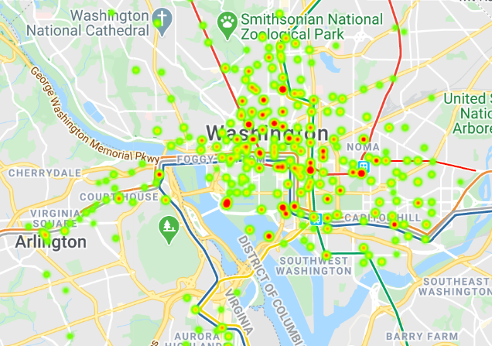
Heat map
Notes:
Travis will go over Heat Map

Slide 29
conclusion
Weather impact in Bike Count
Time and Season when bikeshare is on the raise
Bike stations and accessibility
Growth of bikeshare
Notes:
Travis:
Rental Bikes are more convenient than owing a personal bike
-More convenient in cities and more populated cities/states
Hour of the day and temperature are the two most important factors
that drives the demand of bike sharing rental.

Slide 30
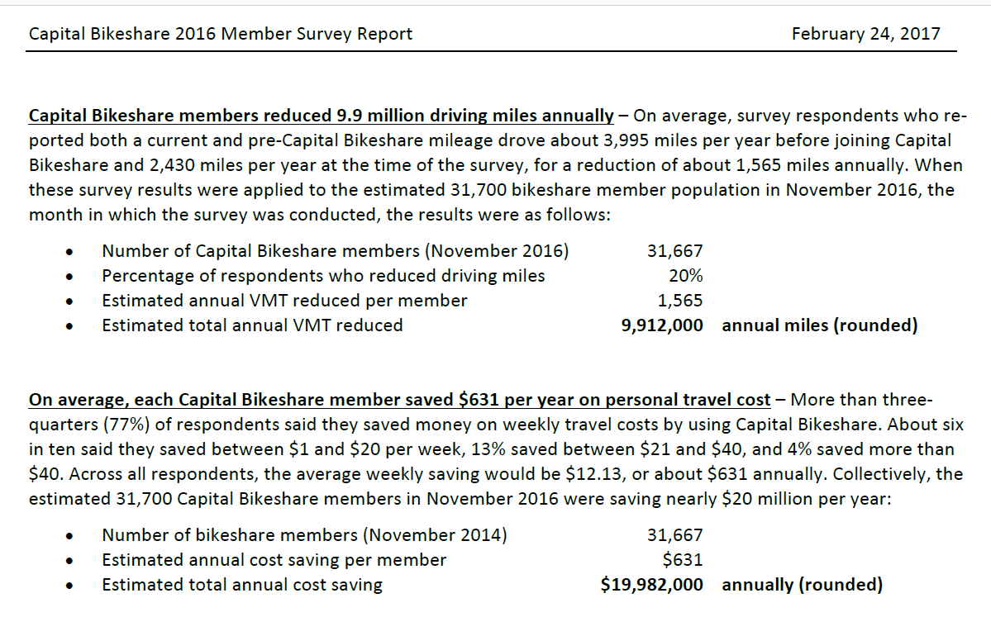
From Capital Bike Share Survey Reports
Notes:
Laci will go over this part regarding Capital Bike Share Survey reports:
Total annual savings as a member: $ 19,982,000 (annually)
--Members saves: $631/year

Slide 31
references
SLIDE | CHART TITLE ( TYPE) | CODE SOURCE
5 | Growth in Bikeshare Locations | Unit 5, Lesson 1, Activity 7&8
6 | Locations in 2011 (Location Map) | Unit 6, Lesson 3, Activity 6
7 | Location Map | Unit 6, Lesson 3, Activity 6
14 | Distribution of Total Rentals (Bar Chart) | Unit 5, Lesson 1, Activity 7&8
16 | Weather Impact on Ride Count (Pie Chart) | Unit 5, Lesson 3, Activities 7&8 Matplotlib: Pie Demo 2
18 | Bike Rental Count in Different Weather Types (Box Plot) | Unit 5, Lesson 3, Activity 2
19 | Bike Count During Seasons (Box Plot) | Unit 5, Lesson 3, Activity 2
23 | Hourly Ride Count (Multi Line Graph) | Unit 5, Lesson 31 Activity 1
24 | Correlation Matrix | Unit 5, Lesson 3, Activity 7
26 | Heat Map | Unit 6, Lesson 3, Activities 7 & 10
Notes:
Derek will go over (provide additional notes):
Our list of references and sources

